Slide 1
Econometrics for dummies About qualitative and nonlinear relationships by Ralf Martin (r.martin@imperial.ac.uk)

Slide 2

Objectives for this lecture
Learn how to deal with modelling qualitative aspects of reality
We can code those with dummy (binary) variables
As explanatory variables
As dependent variables
Appreciate that dummy variables an important building block for constructing more sophisticated models
Allowing for non-linear relationships
Controlling for many potential confounding factors
There are some other easy example of nonlinear models. Let’s look at those.
A bit like

Slide 3
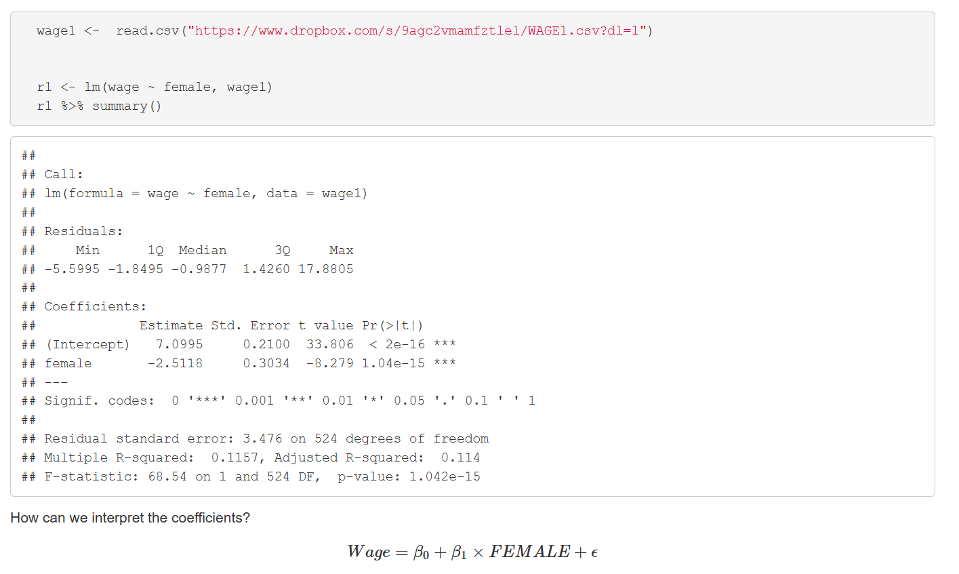
Looking at wage regressions as example again:
Change the x variable by 1 unit. What’s the effect on the Y variable?
i.e. go from male to female, what’s the effect on wages?

Slide 4
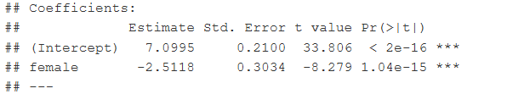
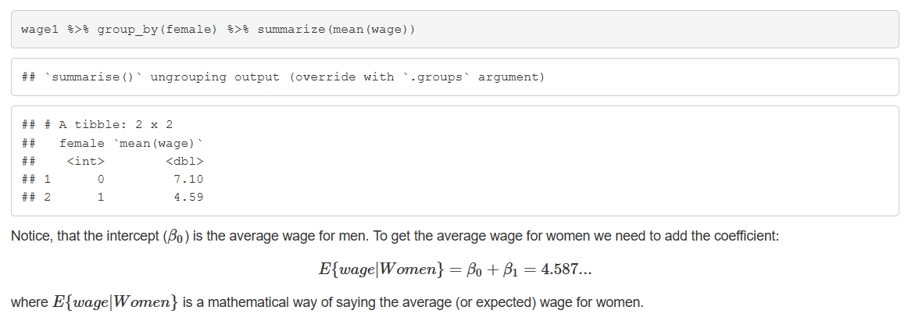
A closer look at those regression coefficients
Average wage
Conditional expectation

Slide 5

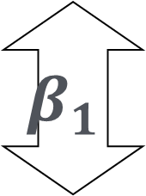
Dummies as bars
The underlying model: $Y=β_{0}+β_{1}FEMALE+ε$
$$β_{0}$$
$$β_{1}$$
Instead of a linear relationship between the x and y variable we we get a nonlinear one
0 1 Female

Slide 6

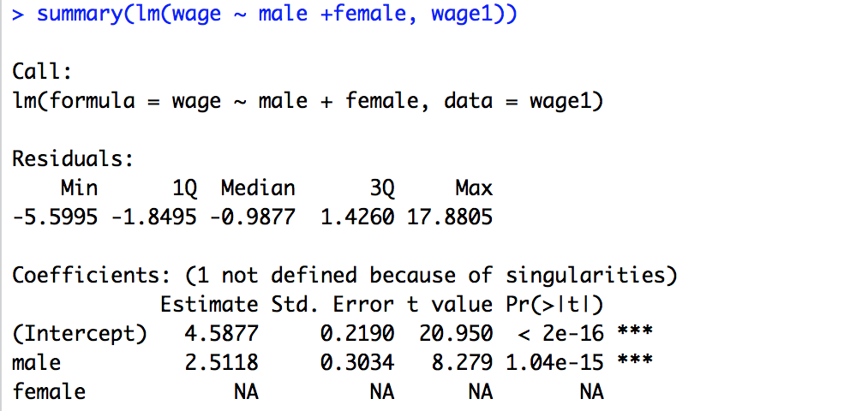
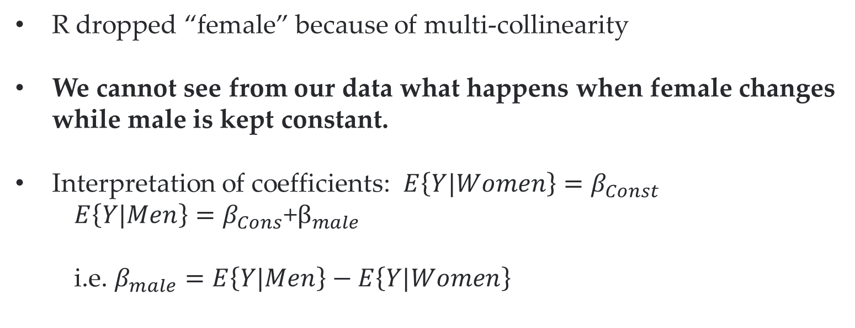
What about men?
R dropped “female” because of multi-collinearity
We cannot see from our data what happens when female changes while male is kept constant.
Interpretation of coefficients: $E\left\{Y|Women\right\}=β_{Const}$
$$E\left\{Y|Men\right\}=β_{Cons}\text{+}β_{male}$$
i.e. $β_{male}=E\left\{Y|Men\right\}−E\left\{Y|Women\right\}$
2 cases in the data. We only need 2 parameters to represent those

Slide 7
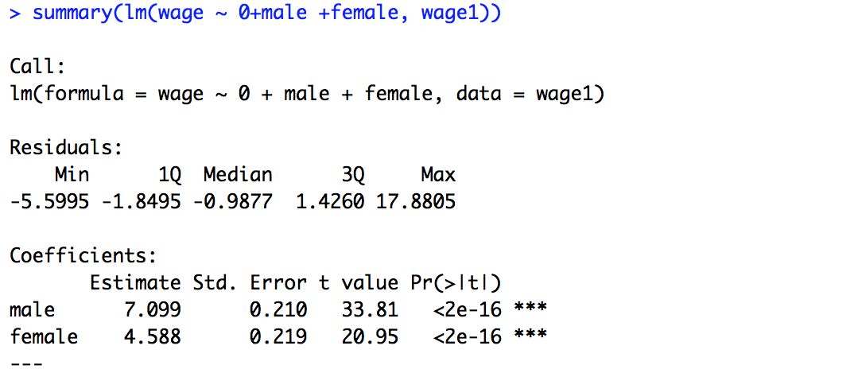
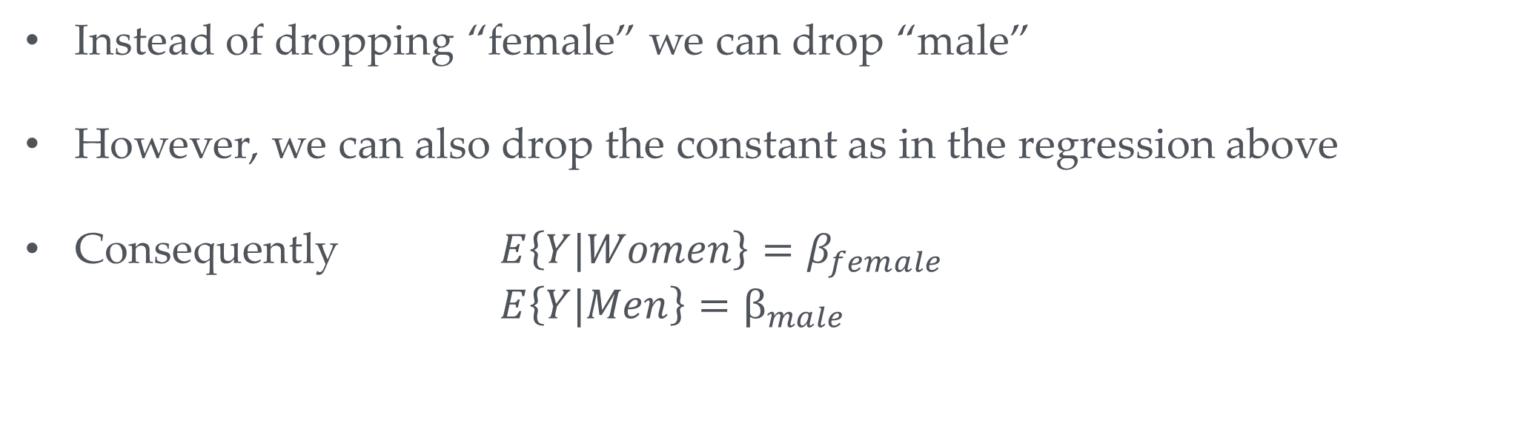
Another option
Instead of dropping “female” we can drop “male”
However, we can also drop the constant as in the regression above
Consequently $E\left\{Y|Women\right\}=β_{female}$
$E\left\{Y|Men\right\}=β_{male}$

Slide 8

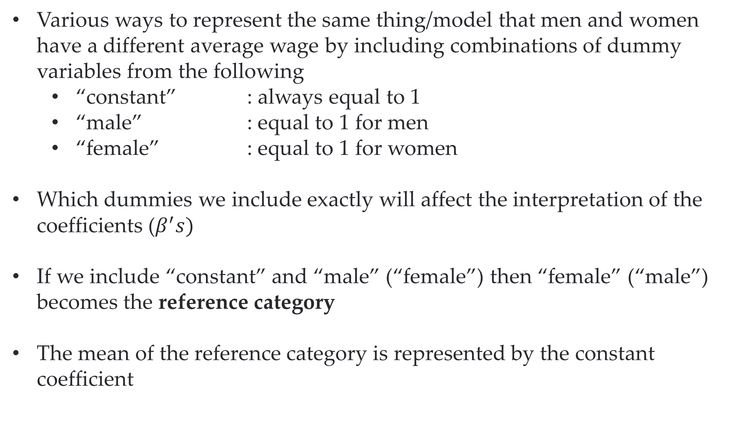
Main take-away
Various ways to represent the same thing/model that men and women have a different average wage by including combinations of dummy variables from the following
“constant” : always equal to 1
“male” : equal to 1 for men
“female” : equal to 1 for women
Which dummies we include exactly will affect the interpretation of the coefficients ($β^{′}s)$
If we include “constant” and “male” (“female”) then “female” (“male”) becomes the reference category
The mean of the reference category is represented by the constant coefficient

Slide 9
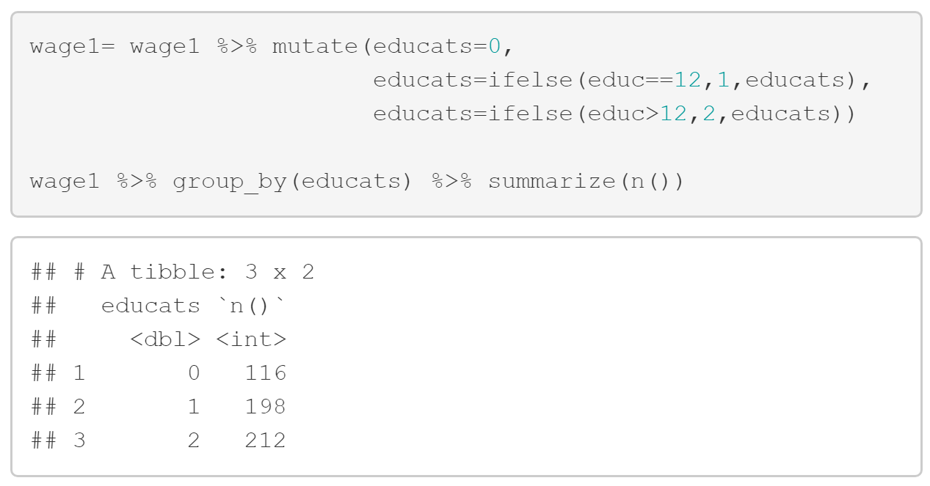
Sets of dummies
Dummies “male” and “female” classify the sample exhaustively
We often have classifications with more than two categories
e.g. rather than having the education in years we might have only a categorical variable capturing 3 levels of education:
Your turn: How would you conduct regression analysis of the relationship between wage and education if all you had was the educats variable?
e.g. lm(wage~educats)
something else?

Slide 10
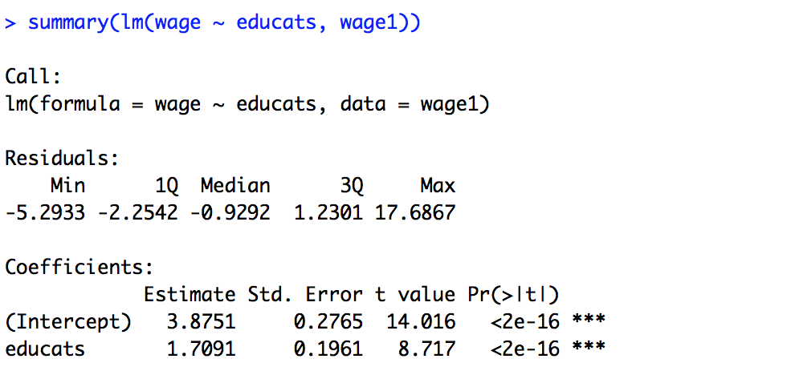
Regression on categorical variable
Can you interpret this coefficient?

Slide 11
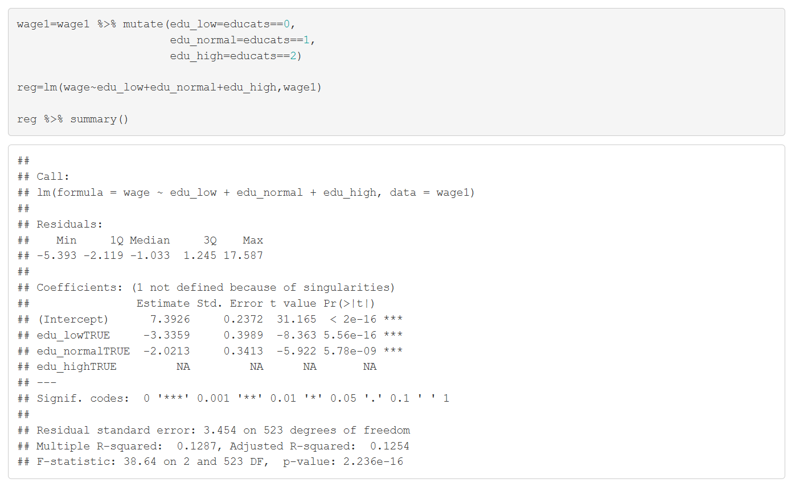
Creating sets of dummies from categories approach 1
We cannot regress dummies for all categories and a constant (dummy variable trap)
R makes sure we don’t fall in the trap and drops one of the dummies (thank you R…that was a close call)

Slide 12
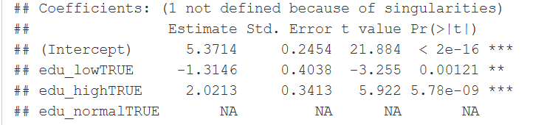



Interpretation
$$β_{eduhigh}$$
$$β_{edulow}$$
$$β_{intercept}$$
Non-linear step function….however linear relationship looks like a fairly good approximation

Slide 13


Testing the validity of a linear model
Linear: A change of 1 in x variable always has the same effect on the y variable
This means in current context
Edu low to mid = Edu mid to high
How to say that in terms of model parameters?
$β_{mid} , β_{high} β_{mid}=\frac{β_{high}}{2}$
$$Wage=β_{0}+β_{edulow}\text{edu}\text{_}\text{low}+β_{eduhigh}\text{edu}\text{_}\text{high}+ε$$
Test $β_{edulow}=−β_{eduhigh}$

Slide 14
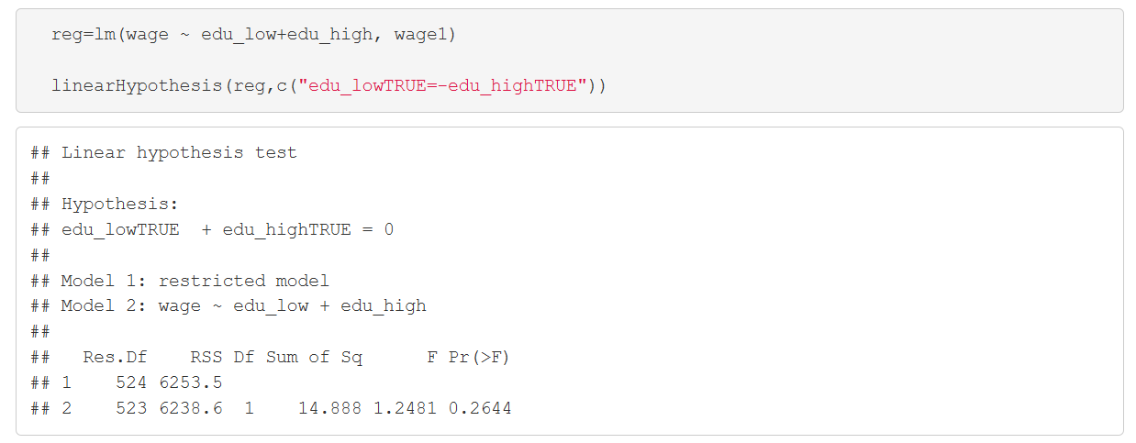
Testing the validity of the linear model
What do you conclude?
High p-value, so we cannot reject. Hence, it would be valid to use the linear model here

Slide 15
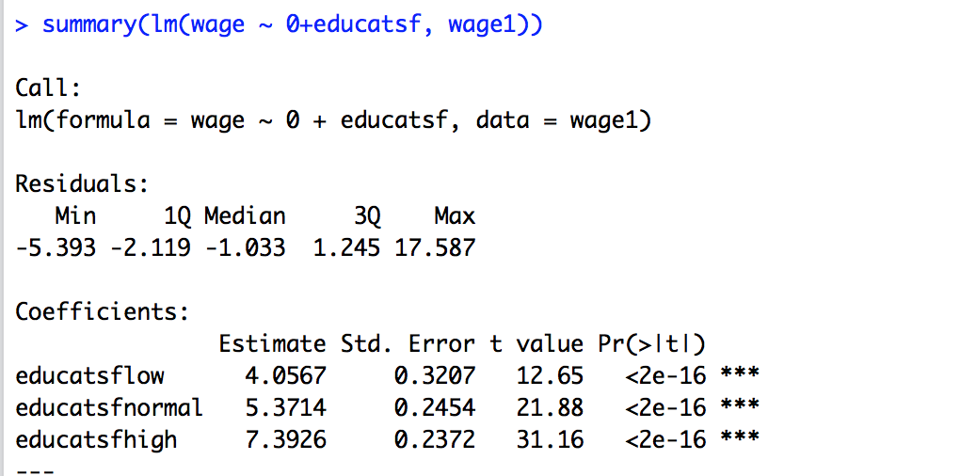
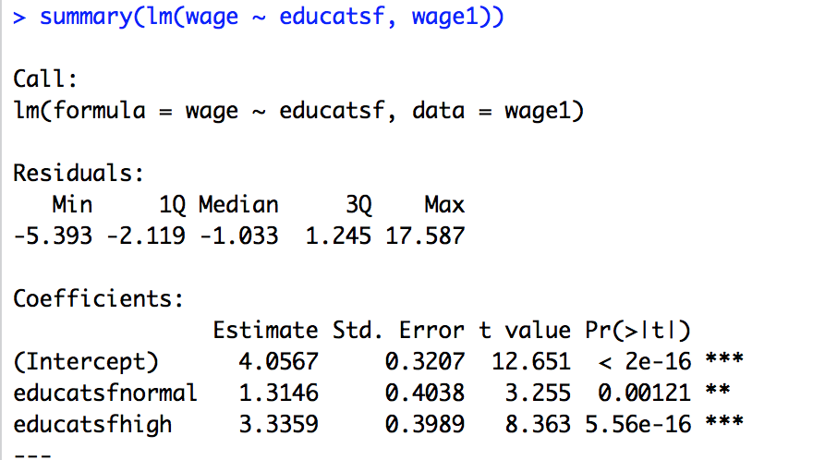
Creating sets of dummies from categories approach 2
Instead of creating a separate dummy variable for every category, we can tell R that we are dealing with a categorical/factor variable
Good if we have a large number of categories
R creates dummy variables automatically

Slide 16
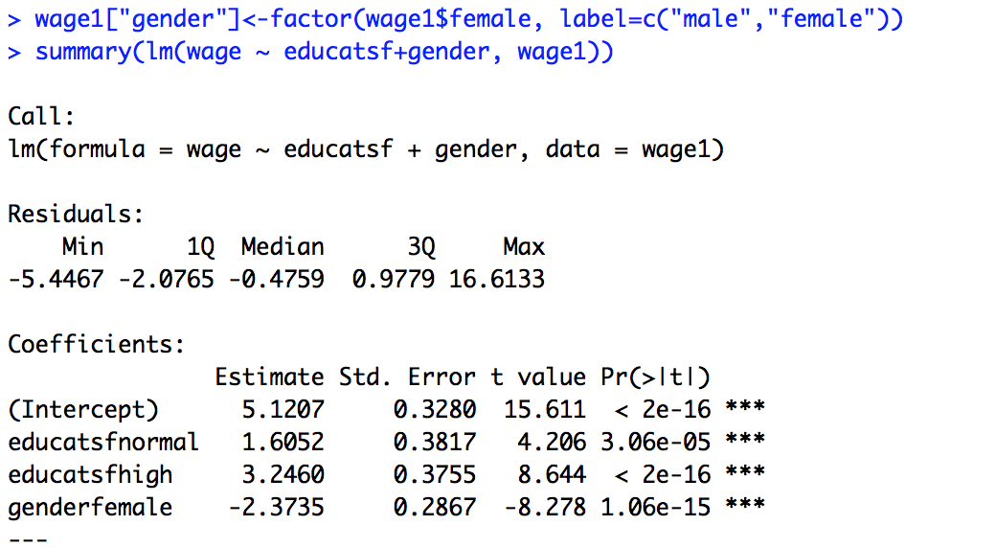

Several Dummy Sets
Implied model: $Wage=β_{C}$
$$+β_{normal}normal+β_{high}high$$
$$+β_{female}female+ε$$
Reference category for education: Low
Reference category for gender: Male

Slide 17


Interpretation
$$Wage=β_{C}+β_{normal}normal+β_{high}high$$
$$+β_{female}female+ε$$
$$β_{C}=E\left\{WAGE|Educ low, Male\right\}$$

Slide 18


Interpretation
$$Wage=β_{C}+β_{normal}normal+β_{high}high$$
$$+β_{female}female+ε$$
$E\left\{WAGE|Educ Low, Female\right\}$=$β_{C}+β_{female}$
$E\left\{WAGE|Educ Normal, Female\right\}$=$β_{C}+β_{female}+β_{normal}$

Slide 19

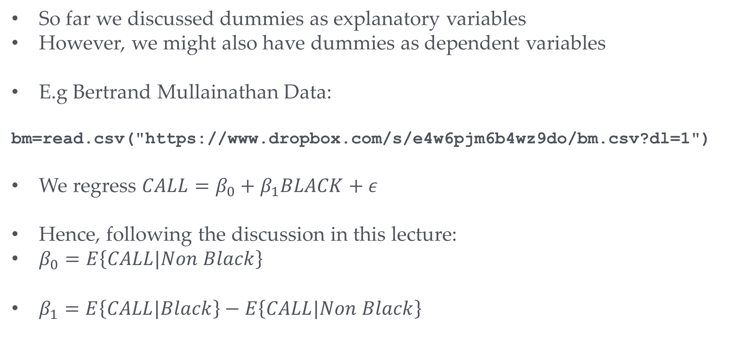
Dummies as dependent variables
So far we discussed dummies as explanatory variables
However, we might also have dummies as dependent variables
E.g Bertrand Mullainathan Data:
bm=read.csv("https://www.dropbox.com/s/e4w6pjm6b4wz9do/bm.csv?dl=1")
We regress $CALL=β_{0}+β_{1}BLACK+ε$
Hence, following the discussion in this lecture:
$β_{0}=E\left\{CALL|Non Black\right\}$
$β_{1}=E\left\{CALL|Black\right\}−E\left\{CALL|Non Black\right\}$
$$CALL=\left\{\begin{matrix}1 call back \\ 0 \text{otherwise}\end{matrix}\right.$$
Average of the CALL variable for Non Black
Difference between average for Black vs Non Black

Slide 20
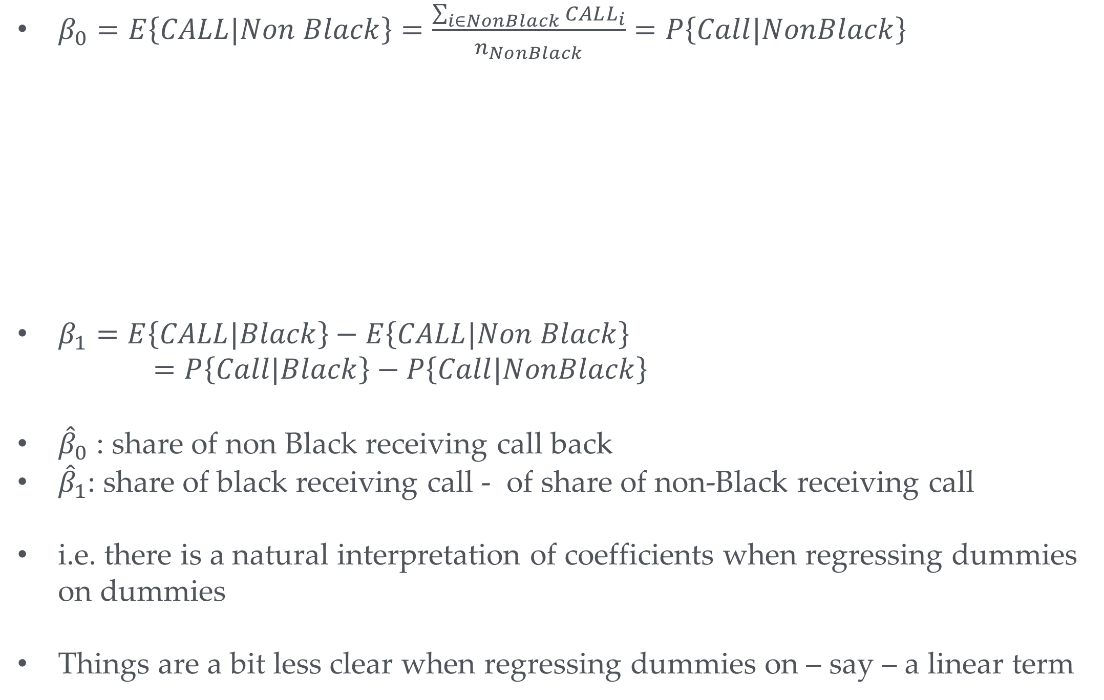
Interpretation of $β$’s with Dummy as dependent variable
$β_{0}=E\left\{CALL|Non Black\right\}=\frac{\sum_{i∈NonBlack}{CALL_{i}}}{n_{NonBlack}}=P\left\{Call|NonBlack\right\}$
$β_{1}=E\left\{CALL|Black\right\}−E\left\{CALL|Non Black\right\}$
$=P\left\{Call|Black\right\}−P\left\{Call|NonBlack\right\}$
${\hat{β}}_{0}$ : share of non Black receiving call back
${\hat{β}}_{1}$: share of black receiving call - of share of non-Black receiving call
i.e. there is a natural interpretation of coefficients when regressing dummies on dummies
Things are a bit less clear when regressing dummies on – say – a linear term
Average CALL foris the sum of CALL divided by number of Non Black people in the sample
Because CALL is either 0 or 1 this is equivalent to the share that received a call back
Which we can think of as an estimate of the call back probability

Slide 21
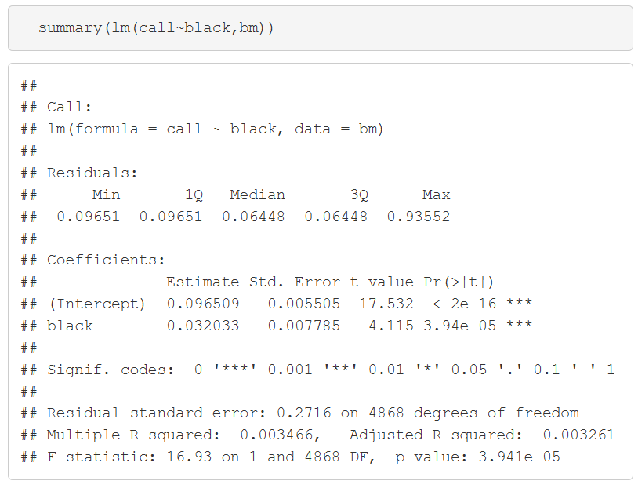
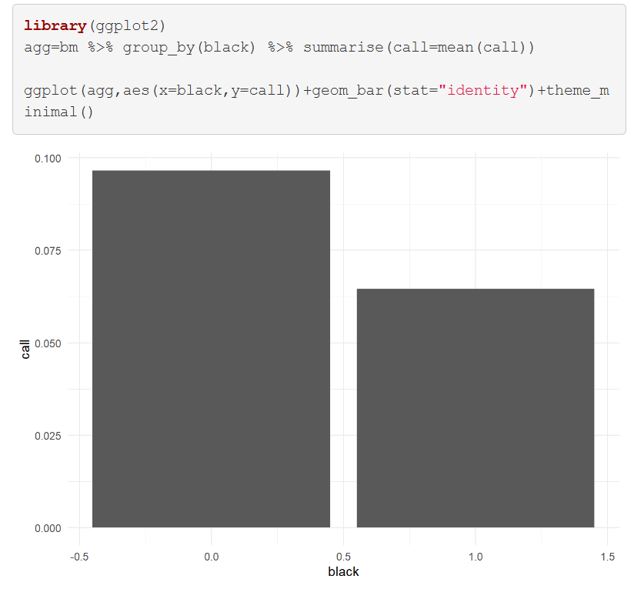
Dummies as dependent variables - In action
CVs with “black” sounding names have a 3.2 percentage point lower chance of receiving a call back

Slide 22
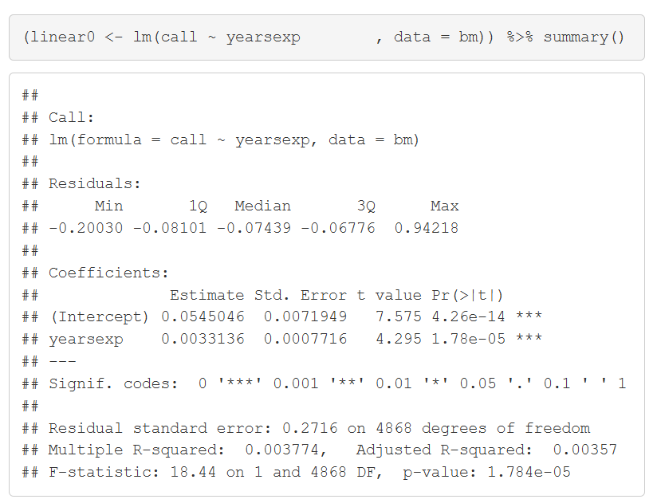
Dummies as dependent variables - linear model case
$$Call=β_{1}+β_{2}Experience+ε$$
Probability of call back increases by 0.3 percentage points with every additional year of experience

Slide 23
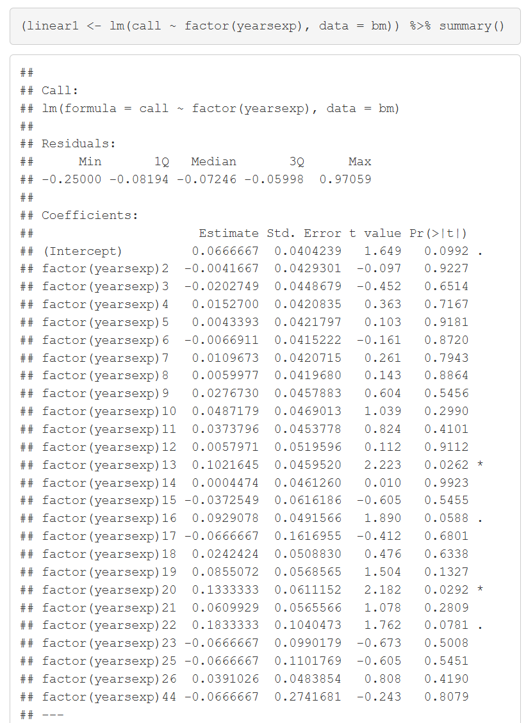
Dummies as dependent variables…and many dummies as explanatory variables as an alternative to a linear relationship
Alternatively use a model with a separate effect for every year of experience; e.g. with 13 years the probability goes up by 10 percentage points relative to reference group

Slide 24
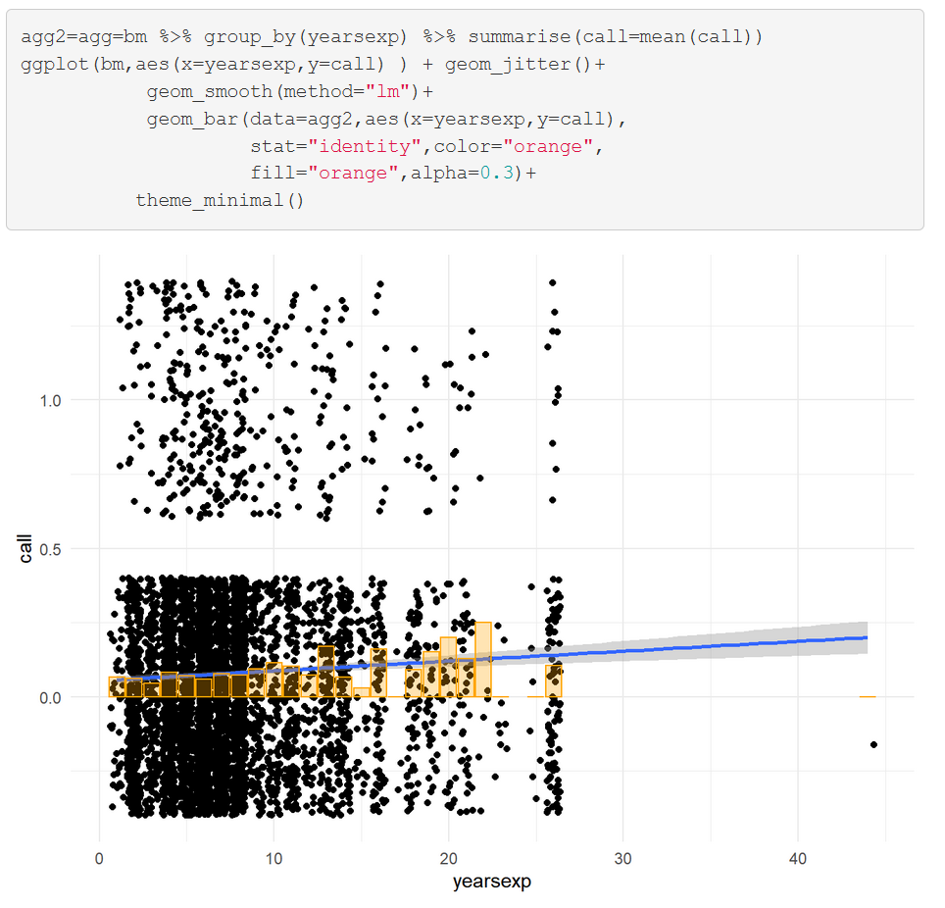
Effect of experience on call back

Slide 25
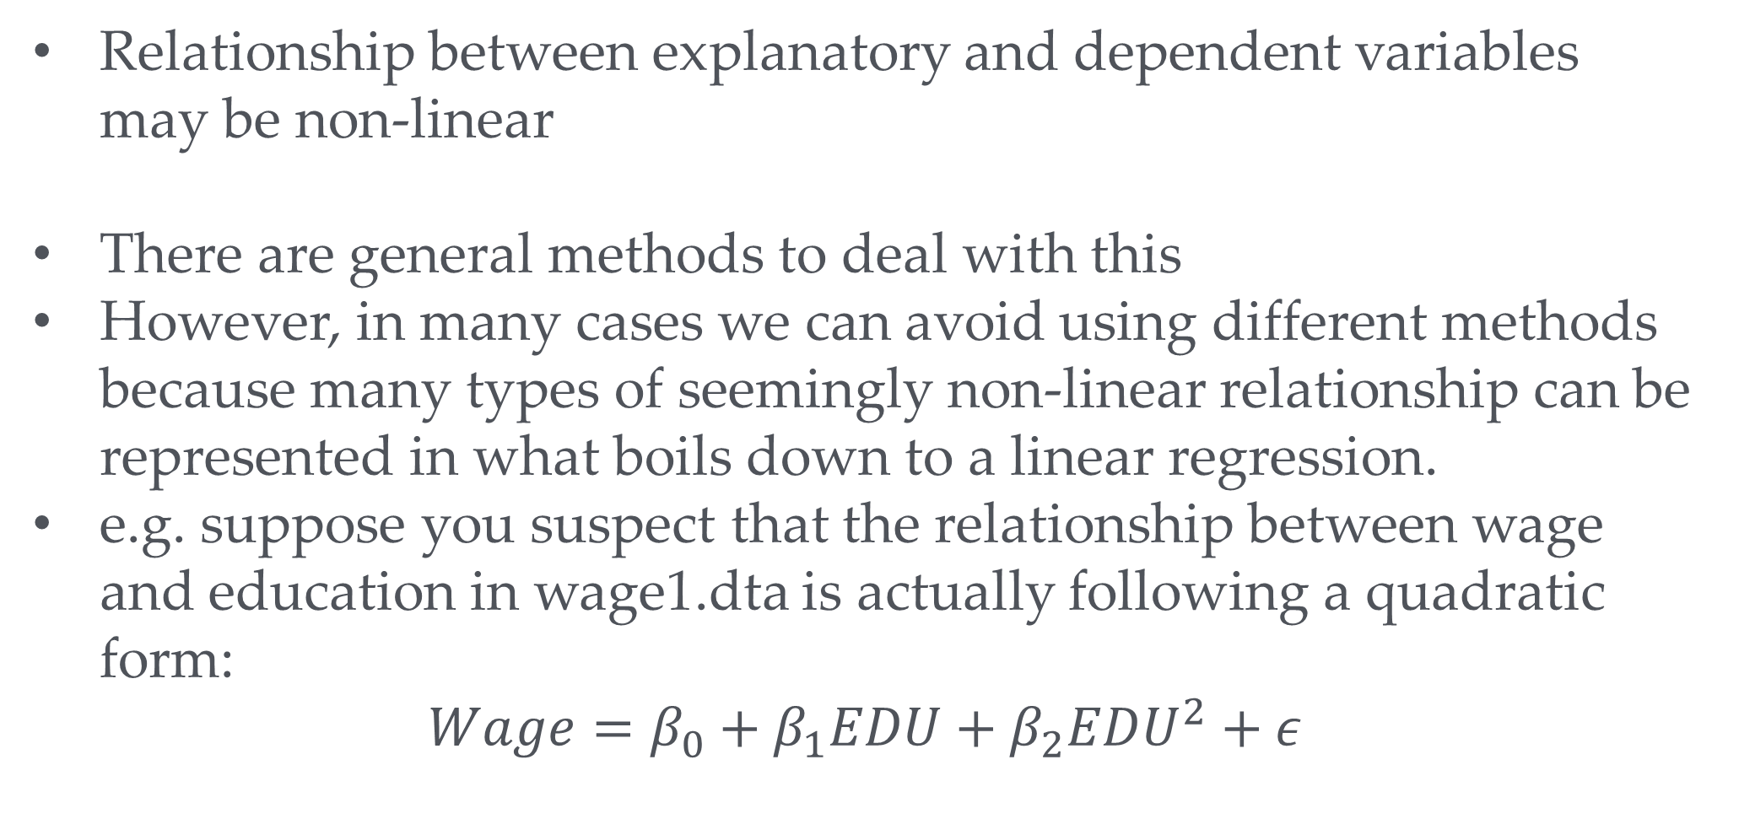
Other non-linear relationships
Relationship between explanatory and dependent variables may be non-linear
There are general methods to deal with this
However, in many cases we can avoid using different methods because many types of seemingly non-linear relationship can be represented in what boils down to a linear regression.
e.g. suppose you suspect that the relationship between wage and education in wage1.dta is actually following a quadratic form:
$$Wage=β_{0}+β_{1}EDU+β_{2}EDU^{2}+ε$$
Your turn: Any ideas how to deal with this?

Slide 26
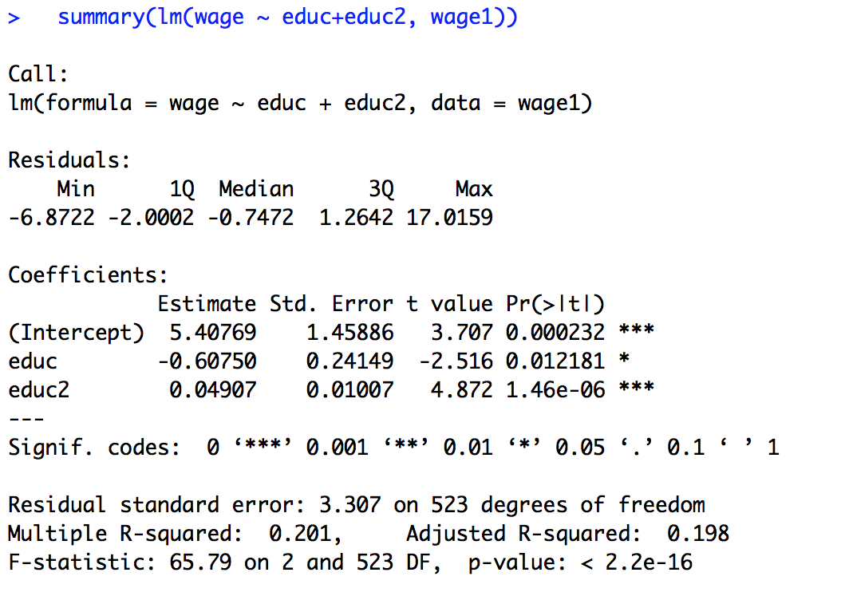
A square relationship
wage1=wage1 %>%
mutate(educ2 =educ^2)
Seems to be significant

Slide 27
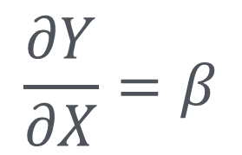
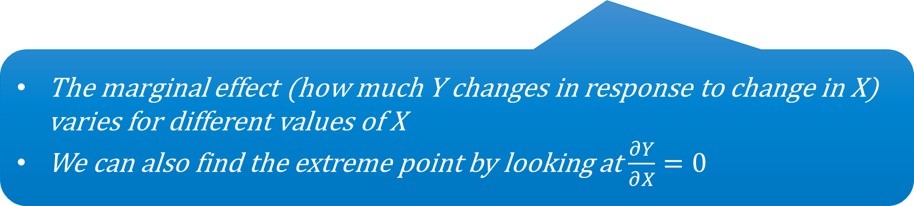

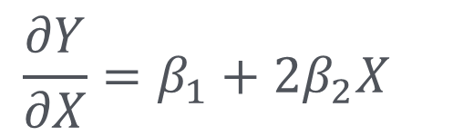
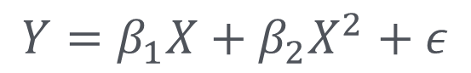

How to interpret things?
Note what we do in the linear case $Y=βX+ε$
$$\frac{∂Y}{∂X}=β$$
In the linear case $β$ is the marginal effect of X on Y
We can work out the same thing in the nonlinear case
$$Y=β_{1}X+β_{2}X^{2}+ε$$
$$\frac{∂Y}{∂X}=β_{1}+2β_{2}X^{}$$
The marginal effect (how much Y changes in response to change in X) varies for different values of X
We can also find the extreme point by looking at $\frac{∂Y}{∂X}=0$

Slide 28
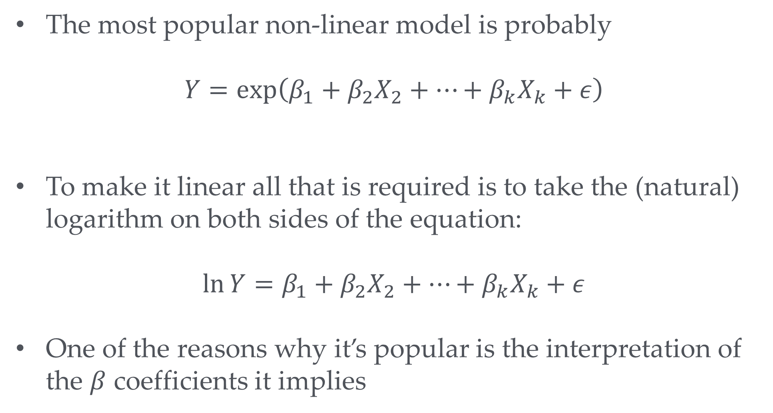
log-linear relationships
The most popular non-linear model is probably
$$Y=\exp\left(β_{1}+β_{2}X_{2}+…+β_{k}X_{k}+ε\right)$$
To make it linear all that is required is to take the (natural) logarithm on both sides of the equation:
$$\ln{Y}=β_{1}+β_{2}X_{2}+…+β_{k}X_{k}+ε$$
One of the reasons why it’s popular is the interpretation of the $β$ coefficients it implies

Slide 29
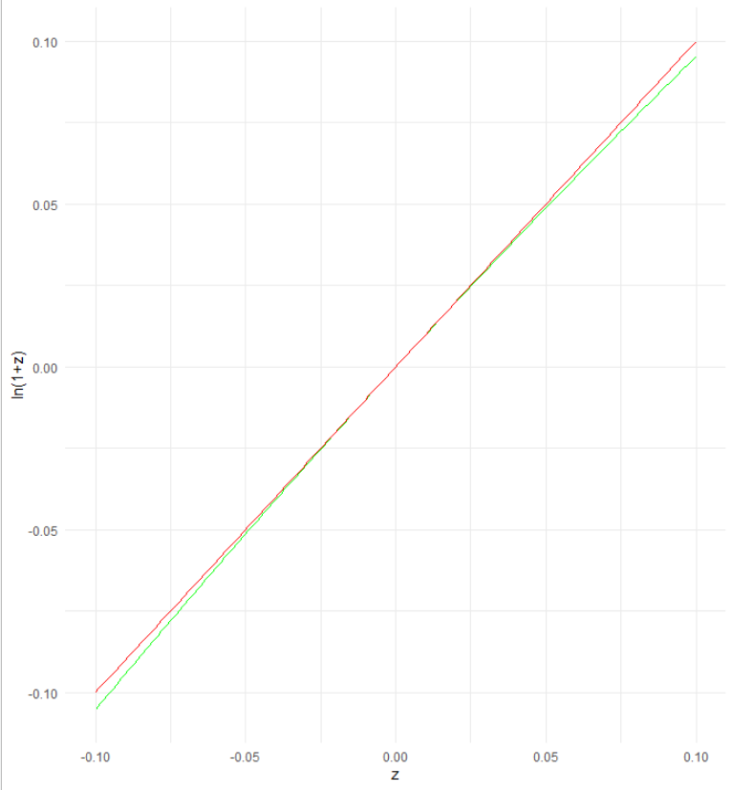
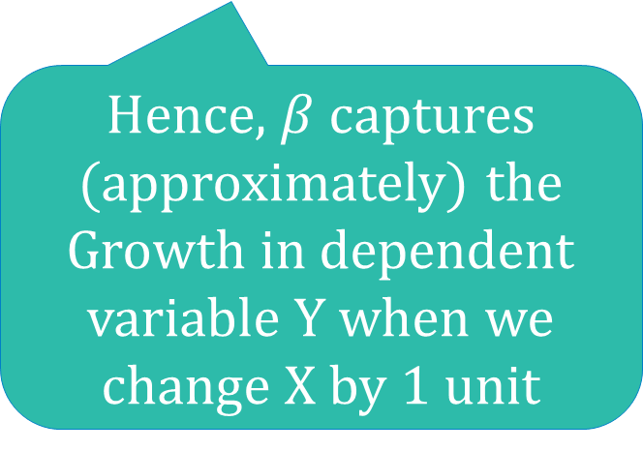
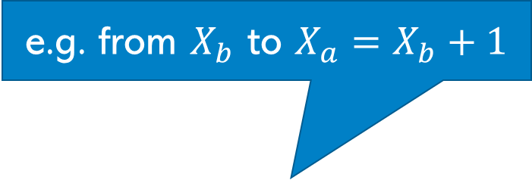
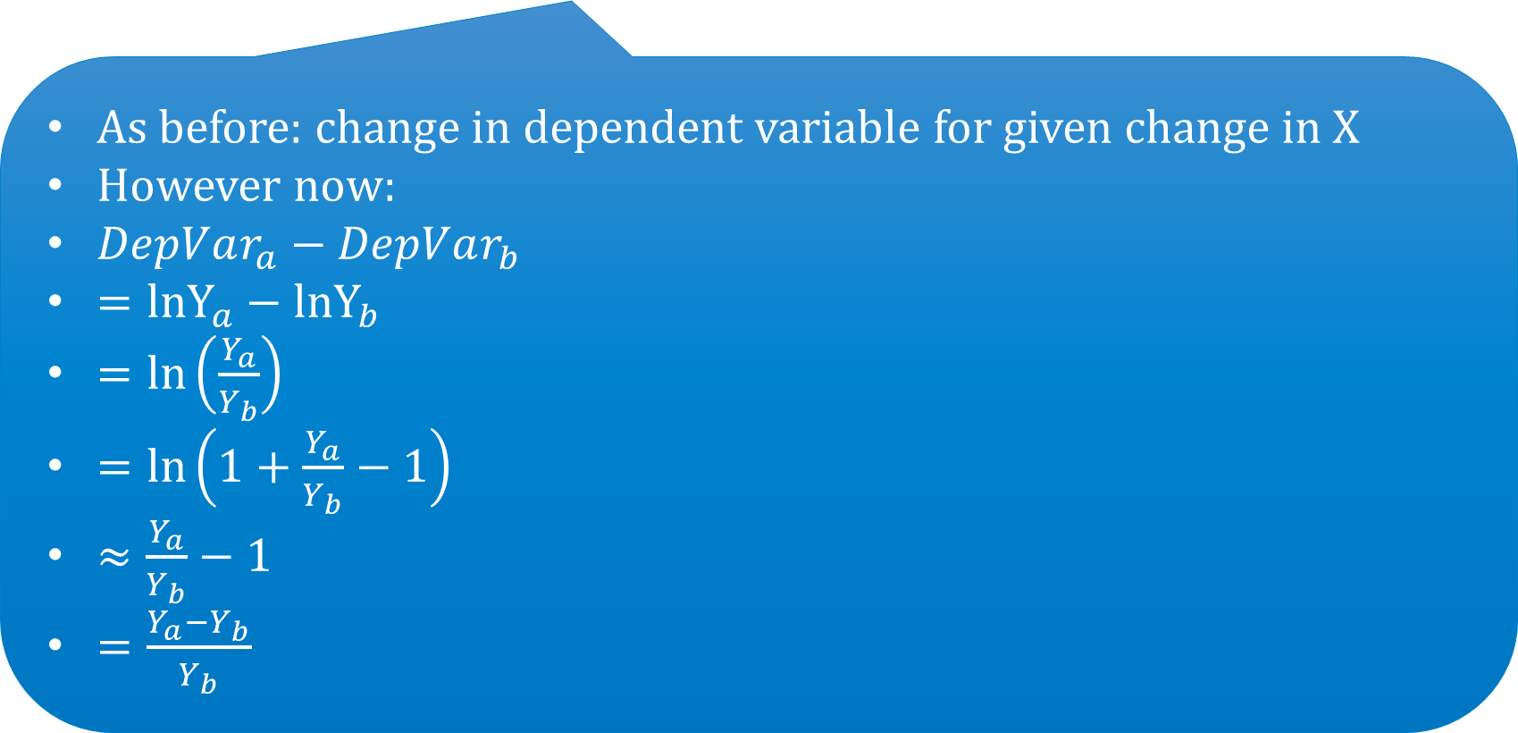
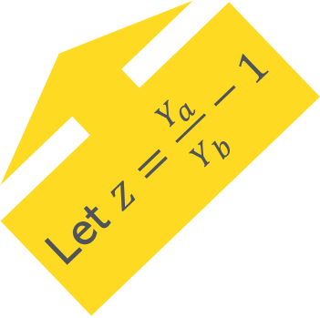
Interpreting log-linear relationships
e.g. from $X_{b}$ to $X_{a}=X_{b}+1$
$$\ln{Y}=…+βX+ε$$
As before: change in dependent variable for given change in X
However now:
$DepVar_{a}−DepVar_{b}$
$={lnY}_{a}−{lnY}_{b}$
$=\text{ln}\left(\frac{Y_{a}}{Y_{b}}\right)$
$=\text{ln}\left(1+\frac{Y_{a}}{Y_{b}}−1\right)$
$≈\frac{Y_{a}}{Y_{b}}−1$
$=\frac{Y_{a}−Y_{b}}{Y_{b}}$
z
Let $z=\frac{Y_{a}}{Y_{b}}−1$
ln(1+z)
Hence, $β$ captures (approximately) the Growth in dependent variable Y when we change X by 1 unit

Slide 30

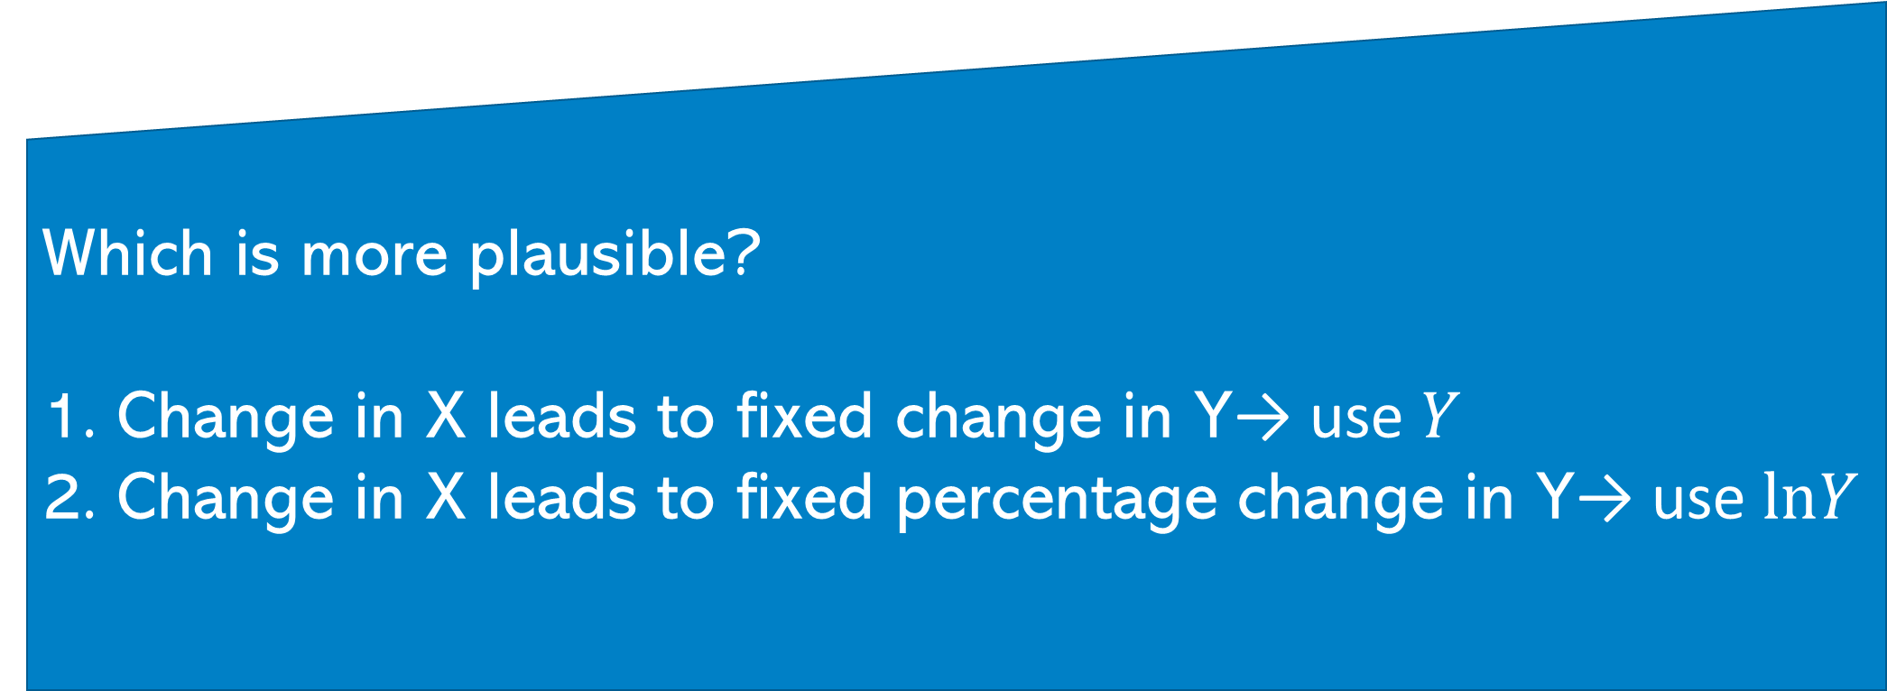
To log or not log?
Which is more plausible?
Change in X leads to fixed change in Y→ use $Y$
Change in X leads to fixed percentage change in Y→ use $lnY$

Slide 31
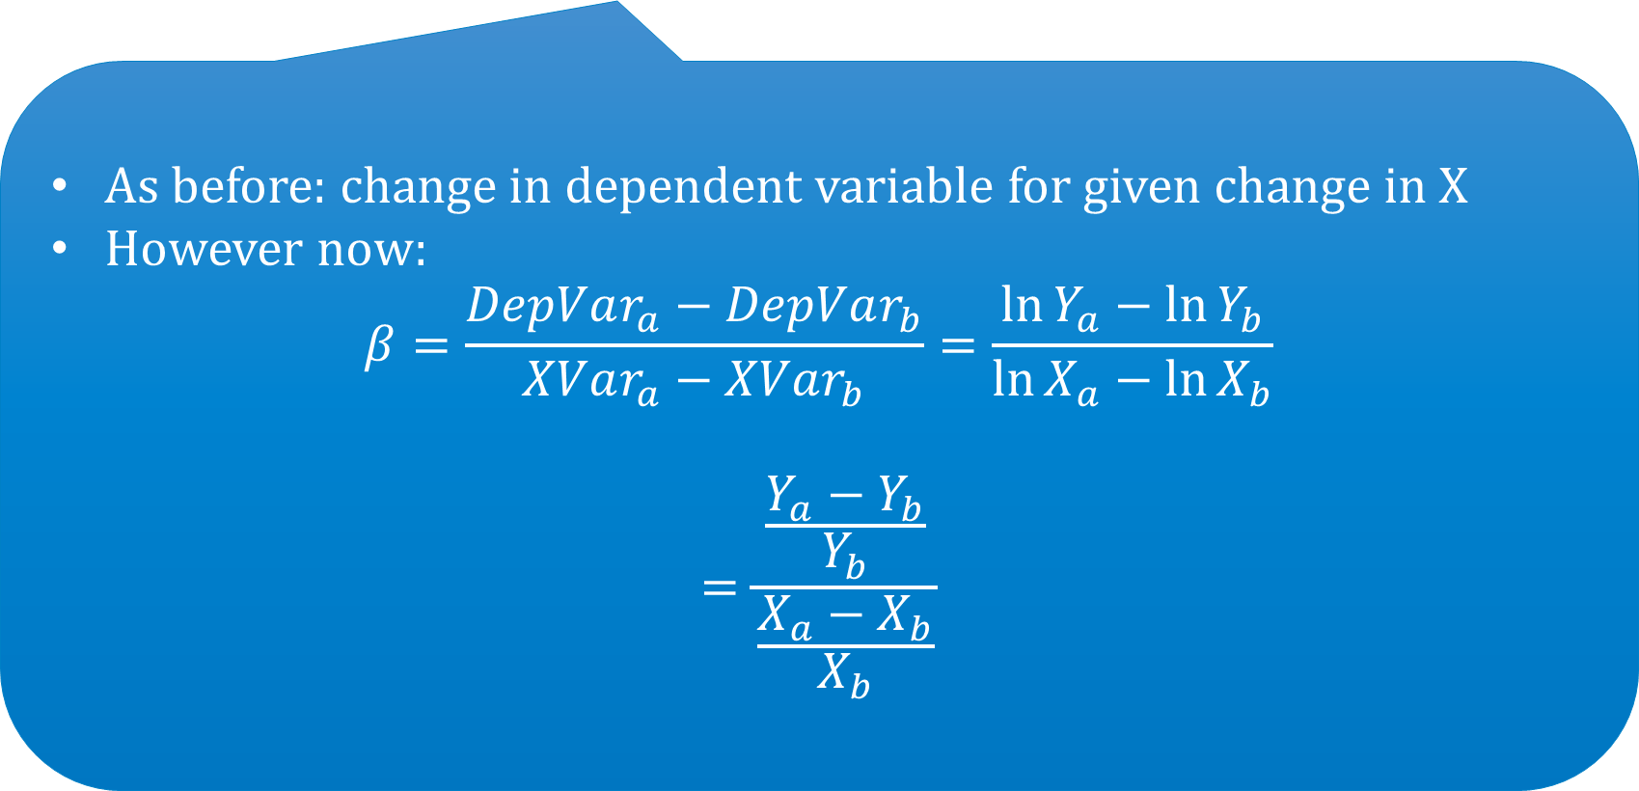
Going log crazy: log log
$$\ln{Y}=…+β_{}{\ln{X}}_{}+ε$$
As before: change in dependent variable for given change in X
However now:
$$β=\frac{DepVar_{a}−DepVar_{b}}{XVar_{a}−XVar_{b}}=\frac{{\ln{Y}}_{a}−\ln{Y_{b}}}{\ln{X_{a}}−\ln{X_{b}}}$$
$$=\frac{\frac{Y_{a}−Y_{b}}{Y_{b}}}{\frac{X_{a}−X_{b}}{X_{b}}}$$
Elasticity

Slide 32

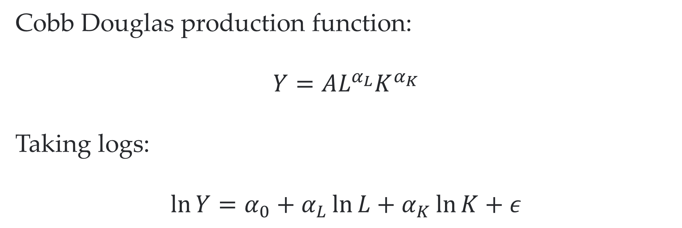
Famous example: production functions
employment
Cobb Douglas production function:
$$Y=AL^{α_{L}}K^{α_{K}}$$
Taking logs:
$$\ln{Y=α_{0}+α_{L}\ln{L+α_{K}\ln{K+ε}}}$$
Value added
capital
Productivity shock: $A_{0}\exp\left(ε\right)$
Elasticity of output with respect to a change in employment

Slide 33
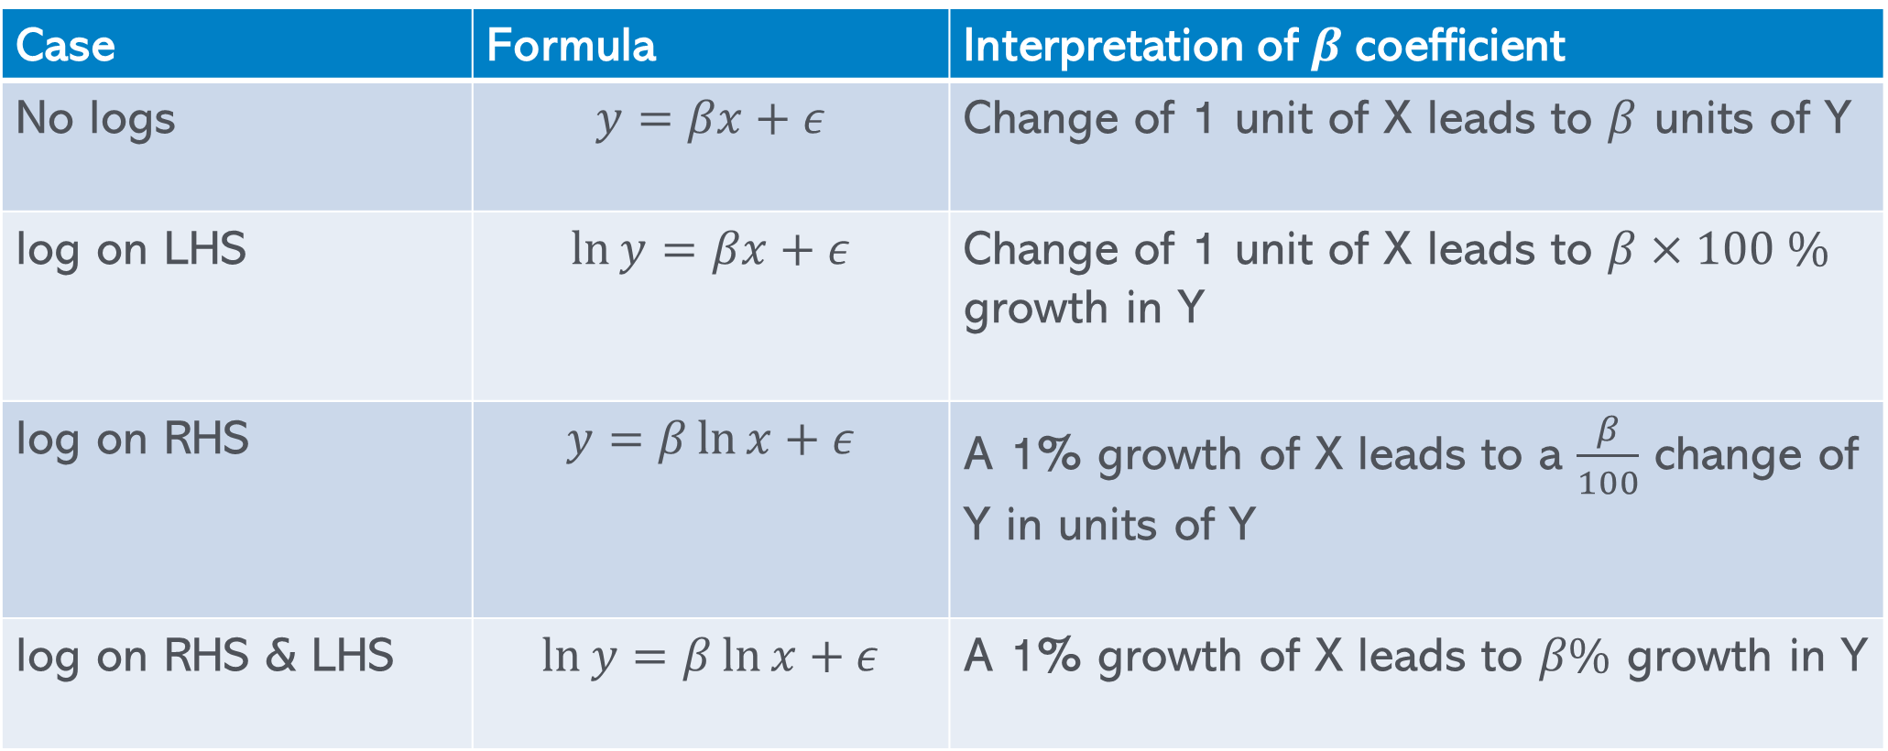
log transformation overview
Case | Formula | Interpretation of $β$coefficient
No logs | $$y=βx+ε$$ | Change of 1 unit of X leads to $β$ units of Y
log on LHS | $$\ln{y}=βx+ε$$ | Change of 1 unit of X leads to $β×100 \%$ growth in Y
log on RHS | $$y=β\ln{x}+ε$$ | A 1% growth of X leads to a $\frac{β}{100}$ change of Y in units of Y
log on RHS & LHS | $$\ln{y}=β\ln{x}+ε$$ | A 1% growth of X leads to $β\%$ growth in Y

Slide 34

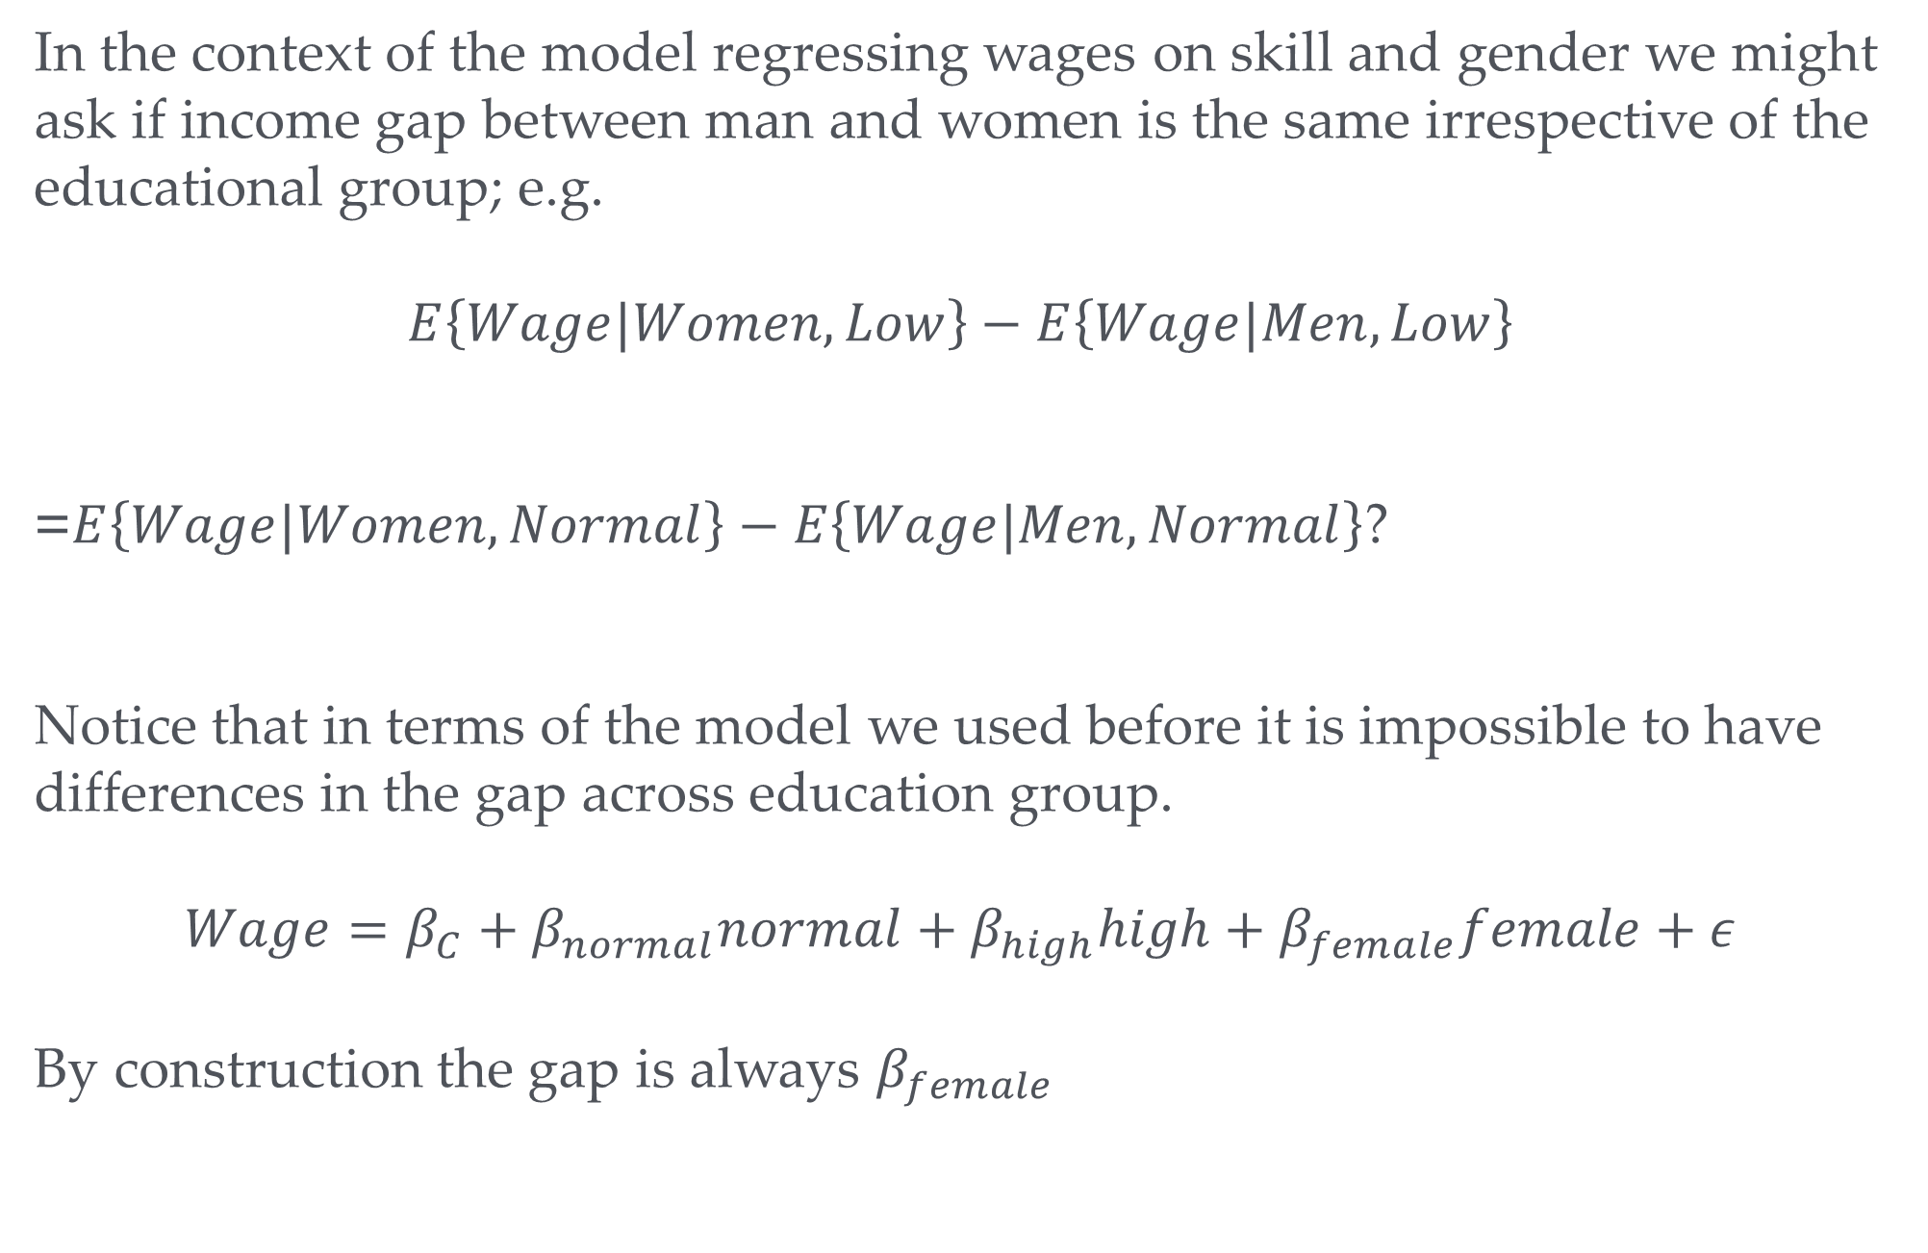





Interactions?
In the context of the model regressing wages on skill and gender we might ask if income gap between man and women is the same irrespective of the educational group; e.g.
$$E\left\{Wage|Women,Low\right\}−E\left\{Wage|Men,Low\right\}$$
=$E\left\{Wage|Women,Normal\right\}−E\left\{Wage|Men,Normal\right\}$?
Notice that in terms of the model we used before it is impossible to have differences in the gap across education group.
$$Wage=β_{C}+β_{normal}normal+β_{high}high+β_{female}female+ε$$
By construction the gap is always $β_{female}$
$${=β}_{female}$$
$${=β}_{c}+β_{female}$$
$${=β}_{c}$$
$${=β}_{female}$$
$${=β}_{c}+β_{female}+β_{normal}$$
$${=β}_{c}+β_{normal}$$

Slide 35
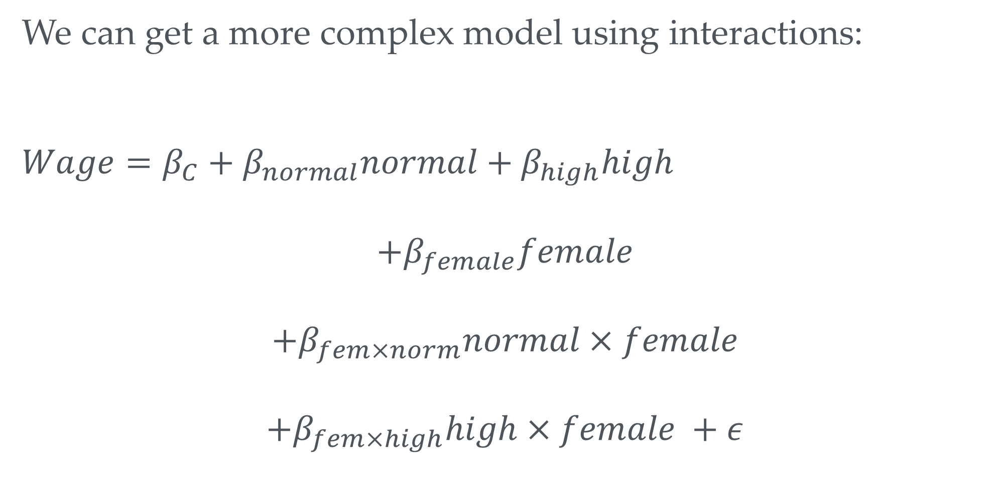
A more complex model
We can get a more complex model using interactions:
$$Wage=β_{C}+β_{normal}normal+β_{high}high$$
$$+β_{female}female$$
$$+β_{fem×norm}normal×female$$
$$+β_{fem×high}high×female +ε$$

Slide 36
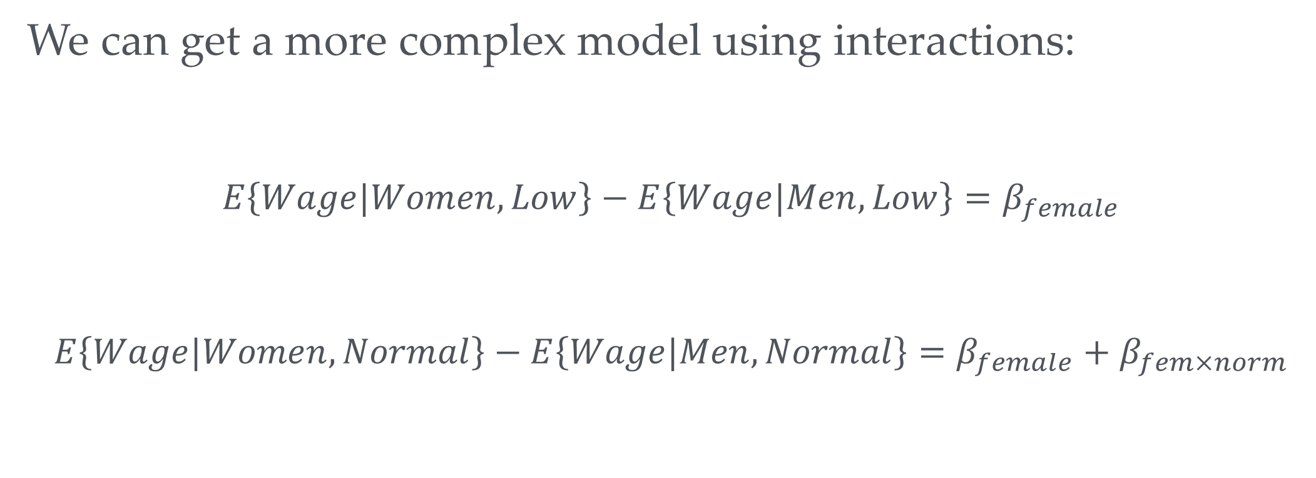
A more complex model
We can get a more complex model using interactions:
$$E\left\{Wage|Women,Low\right\}−E\left\{Wage|Men,Low\right\}=β_{female}$$
$$E\left\{Wage|Women,Normal\right\}−E\left\{Wage|Men,Normal\right\}=β_{female}+β_{fem×norm}$$
How would you test if the wage gap is different for normally educated persons?

Slide 37
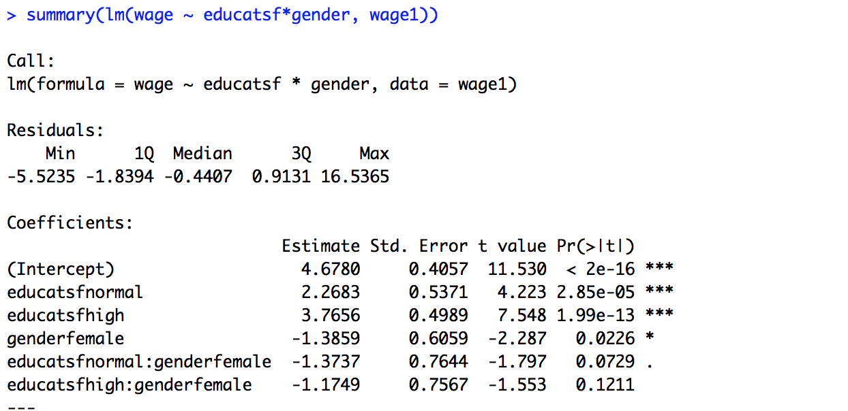
Interactions?
How does the wage gap differ for different educational groups?

Slide 38
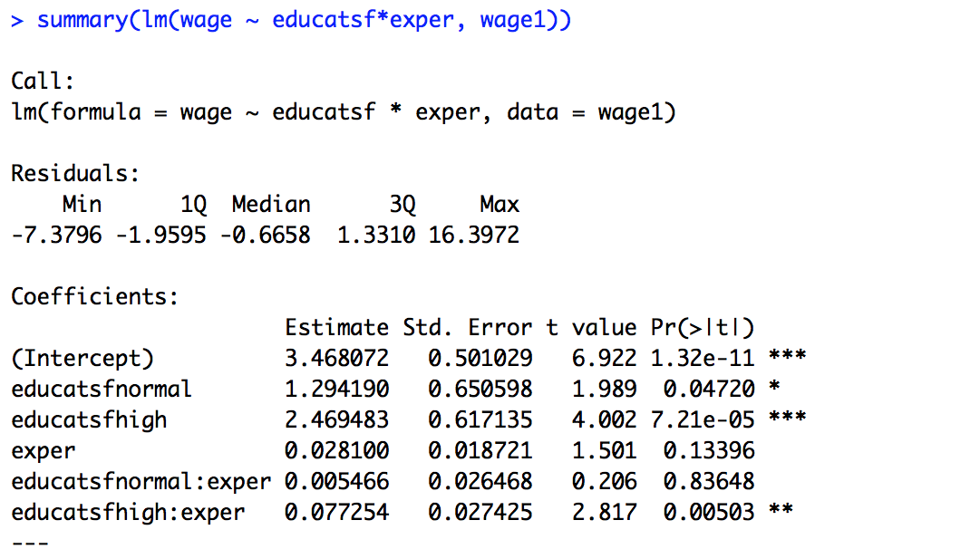
Interactions and continuous variables
Your turn: Does experience affect the educational groups differently?
No
Yes: experience has a bigger impact for the highest educated
Yes: experience has a smaller impact for the highest educated

Slide 39
Interactions and continuous variables

Slide 40
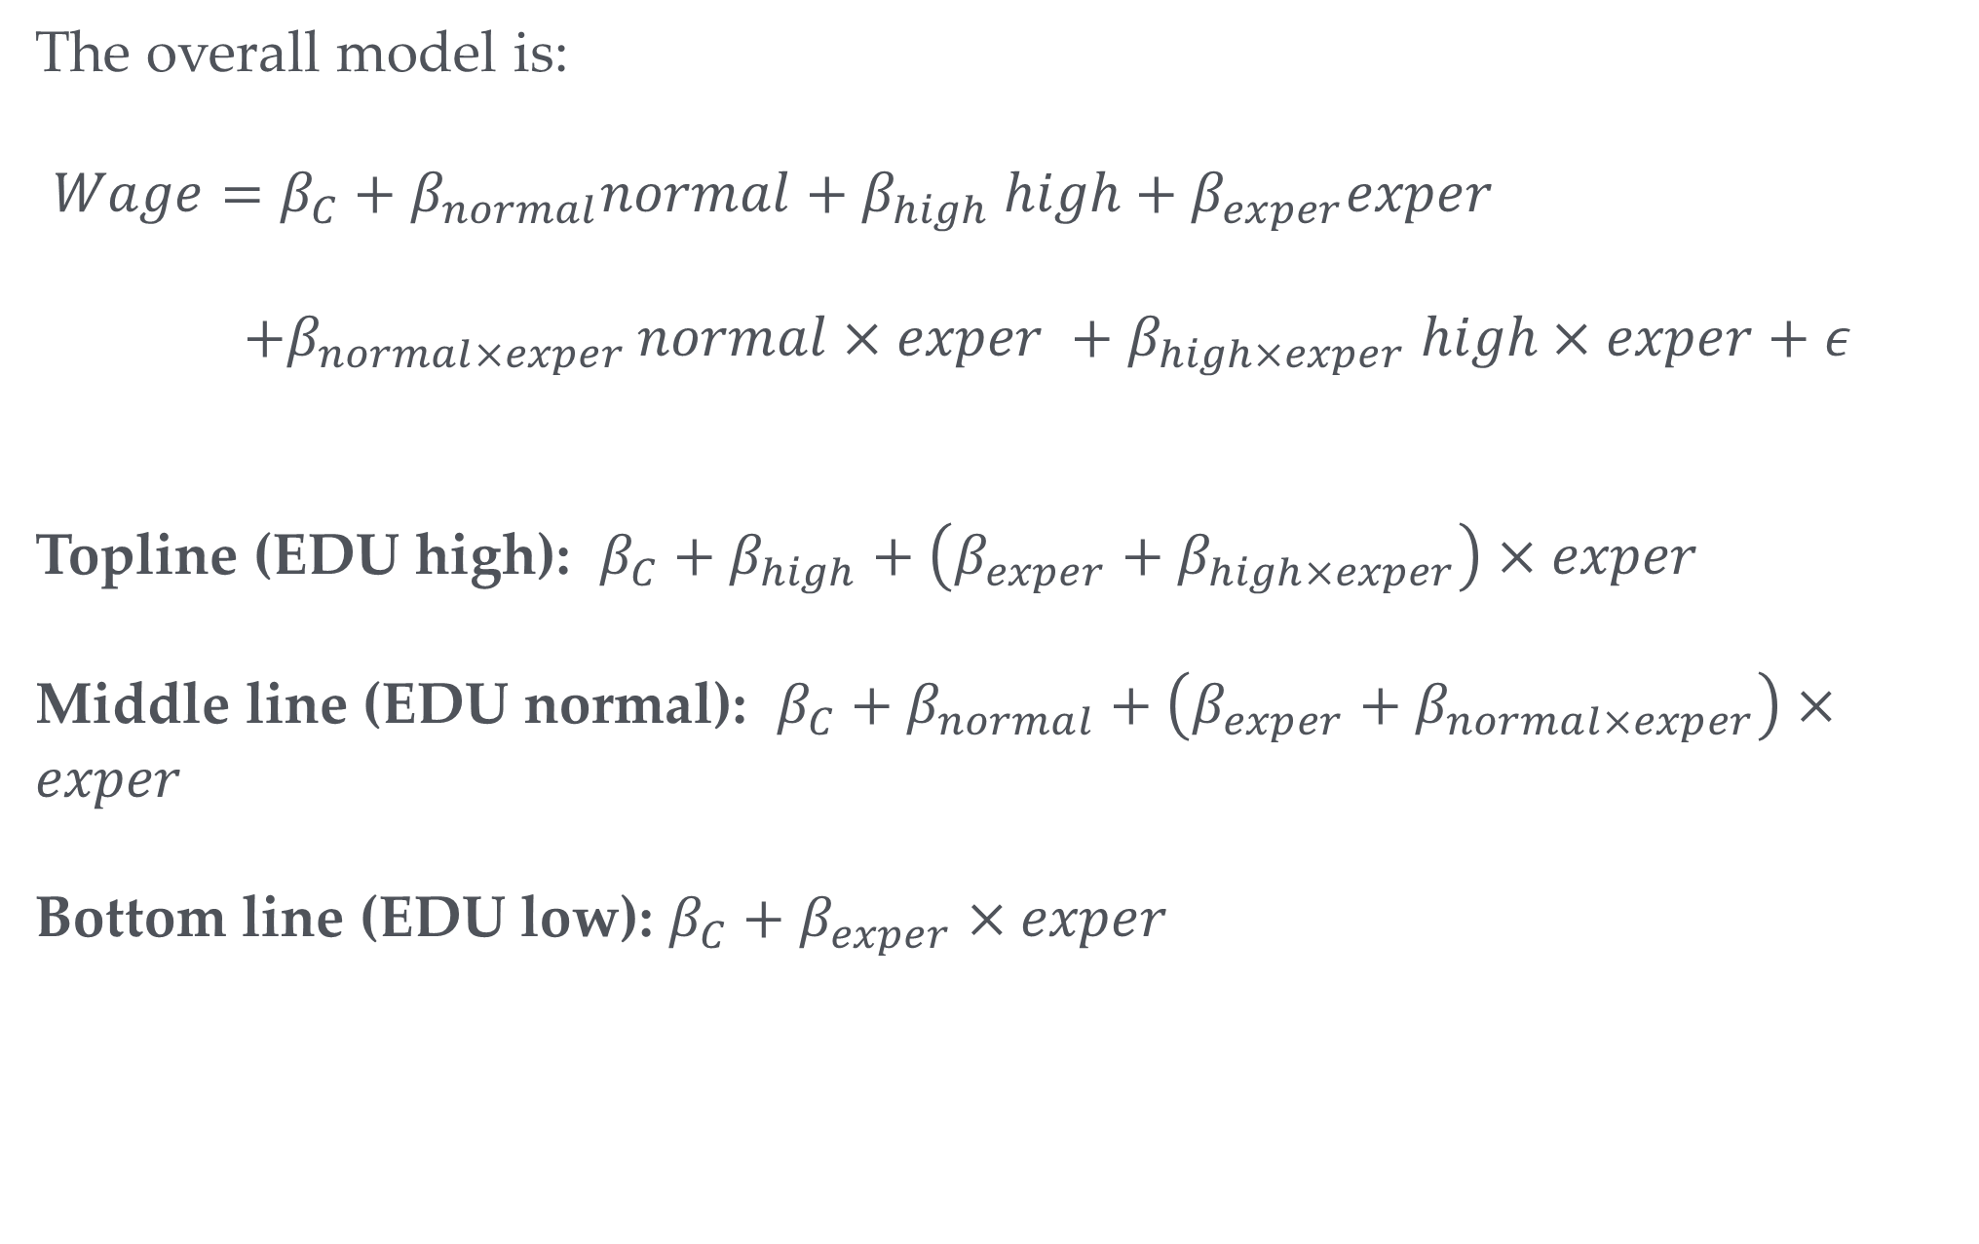
Relating the figure to the model
The overall model is:
$Wage=β_{C}+β_{normal}normal+β_{high} high+β_{exper}exper$
$+β_{normal×exper }normal×exper +β_{high×exper} high×exper+ε$
Topline (EDU high): $β_{C}+β_{high}+\left(β_{exper}+β_{high×exper}\right)×exper$
Middle line (EDU normal): $β_{C}+β_{normal}+\left(β_{exper}+β_{normal×exper}\right)×exper$
Bottom line (EDU low): $β_{C}+β_{exper}×exper$

Slide 41
Summary
Dummies are cool: Model qualitative and non-linear aspects
Don’t fall in the dummy variable trap
The same model can be represented in several ways
Be careful with interpretation of dummies
A lot of stuff that looks non-linear at first glance is linear after all

Slide 42

Extra Slides

Slide 43
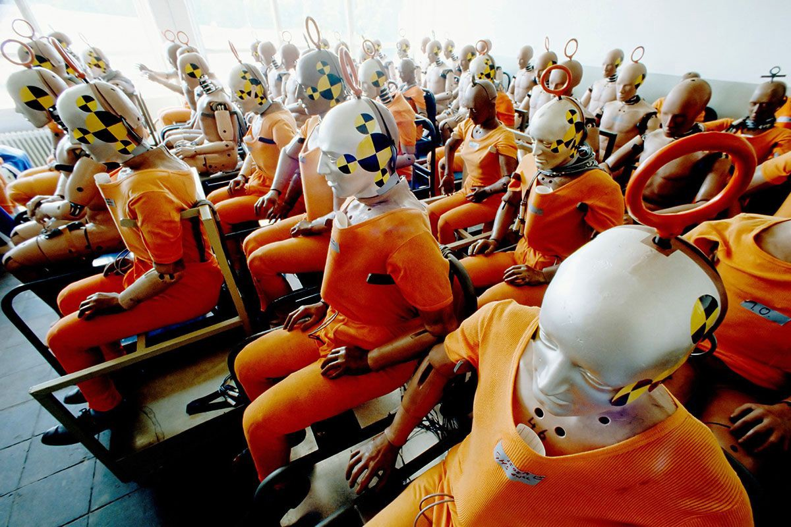
So many dummies
Note that we often use large numbers of dummies in regression models
Helps to control for a wide range of potential confounding factors
Examples:
Sector dummies when using firm level data from several sectors
Regional dummies
Firm dummies when having panel data for firms
Time dummies when having panel data
Accounts for sector level confounding factors

Slide 44
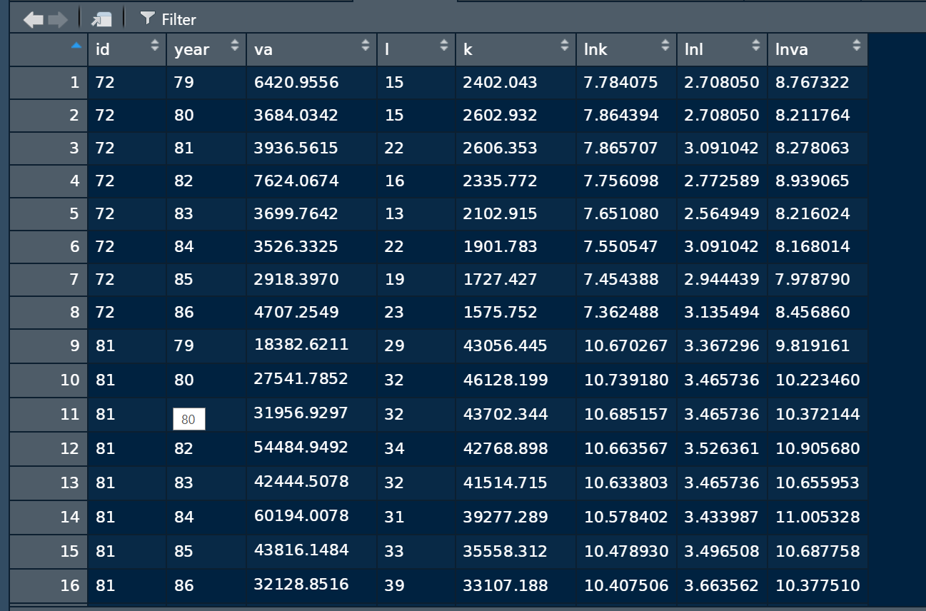
Firm panel data example

Slide 45
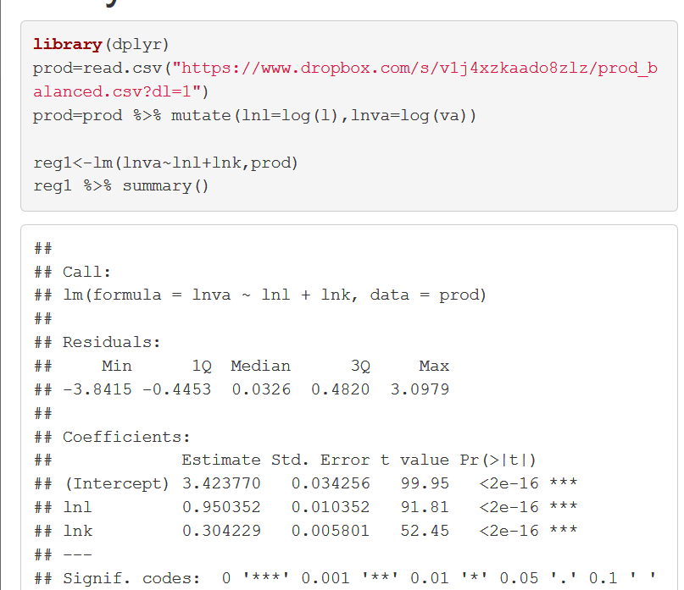
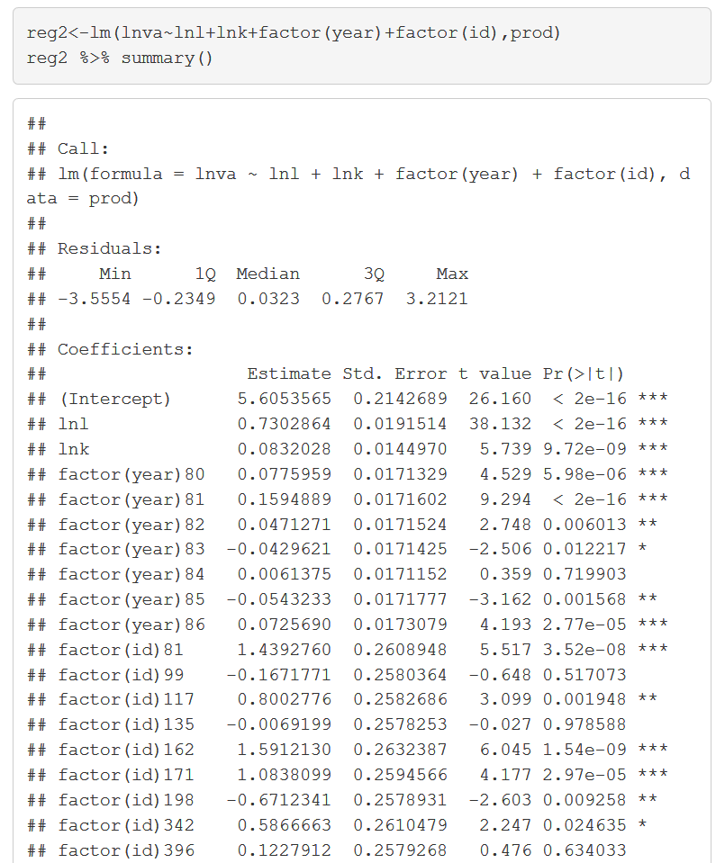
Firm panel data example
Controlling for year effects: e.g. a recession could depress sales (and thus value added) and investment
Controlling for firm effects: successful firms will attract more investment and will have higher sales (and thus value added)

Slide 46



Revisiting dummies
as dependent variables
We saw we could model the probability of the dependent variable equal to 1 as a line
$$P\left(Y_{i}=1|X_{i}\right)=β_{0}+β_{1}X$$
We could interpret $β_{1}$ as the change in probability in response to change in X
More plausible model probability that outcome dummy is 1 with the logistic function:
$$P\left(Y_{i}=1|X_{i}\right)=\frac{1}{1+\exp{(−\left[β_{0}+β_{1}X\right]) }}=g(β_{0}+β_{1}X)$$
Generalized linear model: A linear model inside a non-linear function

Slide 47
Implement logit in R
> library(aod)
> library(margins )
> logit <- glm(call ~ yearsexp, data = bm, family = "binomial")
> summary(logit)
Call:
glm(formula = call ~ yearsexp, family = "binomial", data = bm)
Deviance Residuals:
Min 1Q Median 3Q Max
-0.7780 -0.4075 -0.3924 -0.3779 2.3598
Coefficients:
Estimate Std. Error z value Pr(>|z|)
(Intercept) -2.75960 0.09620 -28.687 < 2e-16 ***
yearsexp 0.03908 0.00918 4.257 2.07e-05 ***
---
Signif. codes: 0 ‘***’ 0.001 ‘**’ 0.01 ‘*’ 0.05 ‘.’ 0.1 ‘ ’ 1
(Dispersion parameter for binomial family taken to be 1)
Null deviance: 2726.9 on 4869 degrees of freedom
Residual deviance: 2710.2 on 4868 degrees of freedom
AIC: 2714.2
Number of Fisher Scoring iterations: 5

Slide 48



How to interpret things?
Note what we do in the linear case $Y=βX+ε$
$$\frac{∂Y}{∂X}=β$$
In the linear case $β$ is the marginal effect of X on Y
We can work out the same thing in the nonlinear case

Slide 49


How to interpret things?
Compute marginal effect on of variable on probability of Y=1
$$\frac{∂P\left(Y_{i}=1|X_{i}\right)}{∂X_{i}}=\frac{\exp\left(−\hat{β}X_{i}\right)\hat{β}}{{\left[1+\exp\left(−\hat{β}X_{i}\right) \right]}^{2} }$$
Not constant for different observations. So we have to compute for every observation separately. Or at specific observations we are interested in.
R margins() command will help
Can be compared to linear probability model

